Slide 1


Mastering Pandas: From Basics to Expert Level
Powerful Data Analysis & Manipulation with Python
Dated: 24 July 2025
Instructor : Fawad Bahadur
Github: bahadurCorvit

Slide 2
Training Objectives & Outcomes
1
Understand the fundamentals of Pandas Series and DataFrames
2
Perform efficient data cleaning, filtering, and transformation
3
Master advanced techniques like grouping, merging, reshaping, and time series handling
4
Apply Pandas to real-world data analysis, reporting, and machine learning workflows
Instructor : Fawad Bahadur

Slide 3



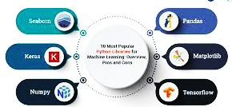
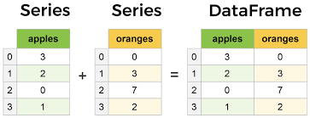
Introduction to Pandas
What is Pandas?
- Open-source Python library for data manipulation and analysis.
- Provides powerful data structures: Series and DataFrame.
- Built on top of NumPy, designed for working with structured data.
Why Use Pandas?
- Easy handling of missing data.
- Flexible reshaping and pivoting.
- Powerful group-by functionality.
- Supports time series data.
Example:
import pandas as pd
data = {'Name': ['Alice', 'Bob', 'Charlie'], 'Age': [25, 30, 35]}
df = pd.DataFrame(data)
print(df)
Instructor : Fawad Bahadur

Slide 4

Setting Up Pandas in Your Environment
What is Pandas?
Open-source Python library for data analysis and manipulation
Built on top of NumPy
Prerequisites-
Python installed (preferably 3.6 or above)
pip (Python package installer)
Installation Using pip:
pip install pandas
Verify Installation:
import pandas as pd
print(pd._version_)
Instructor : Fawad Bahadur

Slide 5
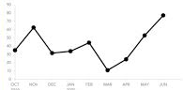
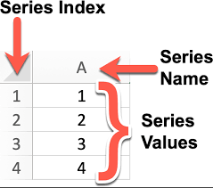
Pandas Series
What is a Series?
- One-dimensional labeled array.
- Can hold any data type (integers, strings, floats, etc.).
- Labels (index) identify each element.
Creating a Series
import pandas as pd
s = pd.Series([10, 20, 30, 40], index=['a', 'b', 'c', 'd'])
print(s)
Accessing Data
print(s['b']) # 20
print(s[1]) # 20 (by position)
Series Attributes
Values: returns the data as NumPy array
Index: returns the index labels
Tip
Series is the building block for DataFrame columns.
Instructor : Fawad Bahadur

Slide 6
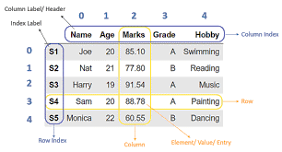
Pandas DataFrame Basics
What is a DataFrame?
Two-dimensional labeled data structure with columns of potentially different types.
Like a spreadsheet or SQL table.
Creating a DataFrame
import pandas as pd
data = {
'Name': ['Alice', 'Bob', 'Charlie'], 'Age': [25, 30, 35],
'Salary': [50000, 60000, 70000]
}
df = pd.DataFrame(data)
print(df)
Accessing Columns
print(df['Name']) # Returns Series of names
Accessing Rows By
index label: df.loc[0]
By integer position: df.iloc[0]
Tip
DataFrame is the core structure for data analysis in Pandas.
Instructor : Fawad Bahadur

Slide 7
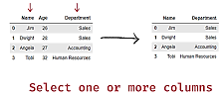
Data Selection & Indexing?
Selecting Columns
df['Age'] # Single column (Series)
df[['Name', 'Age']] # Multiple columns (DataFrame)
Aditional Selection
df[df['Age'] > 25] # Rows where Age > 25
Selecting Rows
Using .loc (label-based)
df.loc[0] # First row by index label
df.loc[0:2] # Rows 0 to 2 inclusive
Using .iloc (integer position-based)
df.iloc[0] # First row by position
df.iloc[0:2] # Rows 0 and 1
Setting Values
df.loc[1, 'Salary'] = 65000
Tip
Use .loc for label indexing and .iloc for positional indexing.
Instructor : Fawad Bahadur

Slide 8
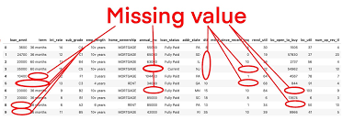
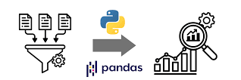
Handling Missing Data?
Detecting Missing Data
df.isnull() # Returns DataFrame of True/False for missing values
df.isnull().sum() # Count missing values per column
Changing Data Types
df['Age'] = df['Age'].astype(float)
Removing Duplicates
df.drop_duplicates(inplace=True)
df.drop_duplicates(subset=['ID', 'Email'], inplace=True)
Tip
Clean and transform your data to prepare it for analysis.
Instructor : Fawad Bahadur

Slide 9
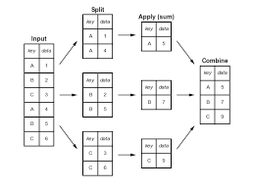
Data Aggregation & Grouping
GroupBy Basics
- Split data into groups based on column values.
- Apply aggregation functions.
Common Aggregation Functions
- .sum()
- .mean()
- .count()
- .min()
- .max()
Example
grouped = df.groupby('AgeGroup')
print(grouped['Income'].mean())
Multiple Aggregations
grouped['Income'].agg(['mean', 'max', 'min'])
Tip
GroupBy is powerful for summarizing data by categories.
Instructor : Fawad Bahadur

Slide 10
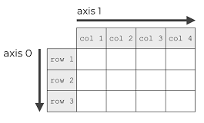
Concatenation in Pandas
Purpose
Used to stack DataFrames or Series vertically or horizontally along an axis.
Functionality
Combines DataFrames by appending them along a specified axis (rows or columns).
Does not perform any relational operations or key-based joining.
Can handle DataFrames with different columns or indices.
Can result in duplicate indices if not handled properly.
Use Case
When you want to combine DataFrames with similar structures or append new data to existing DataFrames without considering common keys.
Code
pd.concat([df1, df2], axis=0) # Vertical (rows)
pd.concat([df1, df2], axis=1) # Horizontal (columns)
Instructor : Fawad Bahadur

Slide 11
Merge in Pandas
Purpose
Used to combine DataFrames based on common columns or indices, similar to SQL joins.
Join Type | Syntax | Returns
Inner | how='inner' | Only matching rows
Left | how='left' | All left rows + matching right
Right | how='right' | All right rows + matching left
Outer | how='outer' | All rows from both
Functionality
Merges two DataFrames based on specified columns or indices.
Supports different types of joins: inner, outer, left, right.
Can handle complex merging scenarios with multiple keys.
Can result in duplicate columns if not handled properly.
Use Case
When you want to combine DataFrames based on related columns, similar to joining tables in a database.
Code
pd.merge(df1, df2, on='key', how='inner') # Inner join
pd.merge(df1, df2, on='key', how='left') # Left join
Tip
Use merging and joining to combine related datasets effectively.
Instructor : Fawad Bahadur

Slide 12
Join in Pandas
Purpose
A specialized version of merge() optimized for joining DataFrames based on their indices or key columns.
Join Type | Syntax | Returns
Inner | how='inner' | Only matching rows
Left | how='left' | All left rows + matching right
Right | how='right' | All right rows + matching left
Outer | how='outer' | All rows from both
Functionality
Combines two DataFrames based on indices or specified key columns.
By default, performs a left join, but other types can be specified
Can be more efficient than merge() when joining on indices.
Use Case
When you want to combine DataFrames based on their indices or specific key columns, similar to joining tables in a database but with a focus on index-based joins.
Code
df1.join(df2, how='outer')
Tip
Use merging and joining to combine related datasets effectively.
Instructor : Fawad Bahadur

Slide 13
Working with Time Series Data
DateTime Index
Use pd.to_datetime() to convert columns to datetime.
df['Date'] = pd.to_datetime(df['Date'])
df.set_index('Date', inplace=True)
Resampling
Aggregate time series data at different frequencies.
df.resample('M').mean() # Monthly average
Time-based Selection
df.loc['2023-01-01':'2023-01-31']
Shifting Data
df['PrevDay'] = df['Value'].shift(1)
Tip
Pandas makes time series manipulation intuitive and powerful.
Instructor : Fawad Bahadur

Slide 14

Handling Text Data in Pandas
String Methods
- Use .str accessor for vectorized string operations.
df['Name'].str.lower() # Convert to lowercase
df['Name'].str.contains('a') # Check if 'a' in string
Extracting Substrings
df['Initial'] = df['Name'].str[0]
Splitting Strings
df['Name'].str.split(' ')
Replacing Text
df['Name'] = df['Name'].str.replace('Alice', 'Alicia')
Tip
Text processing in Pandas is efficient and easy with .str methods.
Instructor : Fawad Bahadur

Slide 15
Reading & Writing Data with Pandas
Reading Data
CSV files
df = pd.read_csv('data.csv’)
Excel files
df = pd.read_excel('data.xlsx', sheet_name='Sheet1’)
JSON files
df = pd.read_json('data.json’)
Writing Data
To CSV
df.to_csv('output.csv', index=False)
To Excel
df.to_excel('output.xlsx', index=False)
Tip
Pandas supports many file formats for easy data import/export.
Instructor : Fawad Bahadur

Slide 16
Optimizing Pandas Performance
Use Vectorized Operations
Avoid loops
use built-in Pandas/NumPy functions.
Use .query() and .eval()
Faster filtering and evaluation.
df.query('Age > 30 & Income > 50000')
Use Categorical Data Type
Reduce memory and speed up operations on repeated values.
Avoid Chained Indexing
Use .loc instead for safe and efficient assignment.
Downcast Numeric Types
df['Age'] = pd.to_numeric(df['Age'], downcast='integer')
Tip
Efficient coding drastically improves speed on large data..
Instructor : Fawad Bahadur

Slide 17
Pandas Integration with Other Libraries
NumPy
Pandas is built on NumPy arrays, enabling fast numerical operations.
import numpy as np
arr = np.array([1, 2, 3])
df = pd.DataFrame(arr)
Scikit-learn
For machine learning pipelines.
from sklearn.model_selection import train_test_split
X_train, X_test, y_train, y_test =
train_test_split(df.drop('target', axis=1), df['target'])
Matplotlib & Seaborn
For data visualization.
df['Age'].plot(kind='hist’)
import seaborn as sns
sns.boxplot(data=df, x='Age')
SQLAlchemy
Read/write data from SQL databases.
from sqlalchemy import create_engine
engine = create_engine('sqlite:///:memory:’)
df.to_sql('table_name', engine)
Tip
Pandas works seamlessly with the Python data ecosystem.
Instructor : Fawad Bahadur

Slide 18

Data Visualization Using Pandas
Basic Plotting
df['Age'].plot(kind='hist', bins=20, title='Age Distribution')
Line Plot
df.plot(x='Date', y='Sales', kind='line')
Bar Plot
df['Category'].value_counts().plot(kind='bar')
Scatter Plot
df.plot.scatter(x='Age', y='Income')
Using matplotlib and seaborn for Enhanced Visualization
sns.boxplot(x='Category', y='Income', data=df)
Tip
Pandas integrates well with visualization libraries for exploratory analysis.
Instructor : Fawad Bahadur

Slide 19
THANK YOU
Instructor : Fawad Bahadur

